Slide 1


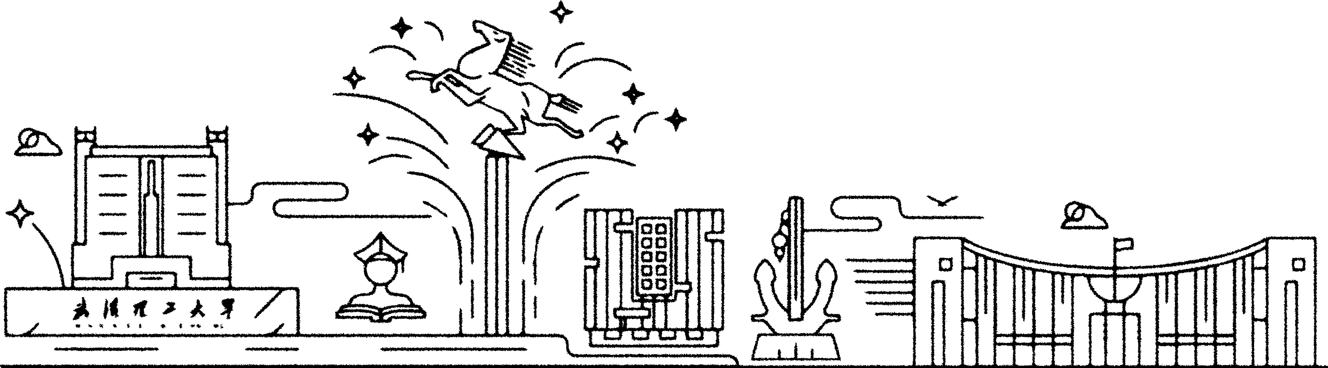
English for Science and Technology
Abstract Writing
Hu Shan 2024.11.13
Notes:
封面

Slide 2
目录
2025
CONTENTS
01
02
03
04
Writing requirements
Basic structure
Writing skills
Example analysis

Slide 3
01
Writing Requirements
PART ONE

Slide 4
Conciseness
Independence
The abstract should be brief and to the point, typically between 150-250 words.
The abstract should be self-contained, allowing readers to understand the main content of the paper without needing to read the entire text.
Objectivity
Keywords
The language of the abstract should be neutral, avoiding personal opinions or subjective evaluations.
Include 5 - 7 keywords to aid in literature search.

Slide 5
02
Basic Structure
PART TWO

Slide 6
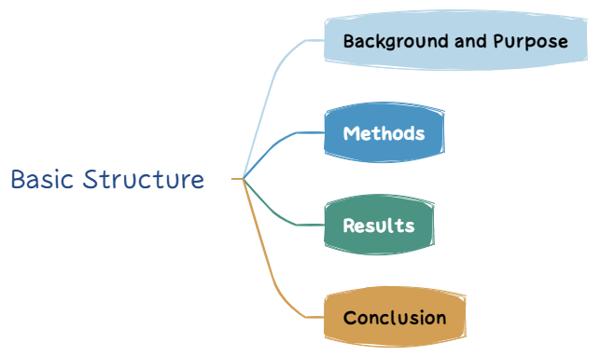

Slide 7
Background and Purpose
Methods
Results
Conclusion
Briefly introduce the background of the research and clearly state the research objective or problem.
Provide a summary of the methods or experimental design used.
Highlight the main findings or outcomes of the research.
Briefly state the conclusions and potential impact of the research.

Slide 8
03
Writing Skills
PART THREE

Slide 9
Precise and Concise Language
Avoid lengthy sentences, and directly convey the core content of the study.
Avoid Abbreviations
Unless the abbreviation is widely recognized (e.g., DNA, AI), avoid using abbreviations.
Use of Tense
Typically, the background section uses past or present perfect tense, methods use past tense, results use past tense, and conclusions use present tense.
No Citations or Data
Abstracts generally do not include citations or detailed data, unless it is crucial to the research.

Slide 10
04
Example analysis
PART FOUR

Slide 11
Abstract:
In recent years, deep learning has been applied in a wide variety of domains and gains outstanding success. In order to achieve high accuracy, a large amount of training data and high-performance hardware are necessary for deep learning. In real-world applications, many deep learning developers usually rent cloud GPU servers to train or deploy their models. Since training data may contain sensitive information, training models on cloud servers will cause severe privacy leakage problem. To solve this problem, we propose a privacy-preserving deep learning model based on matrix transformation. Specifically, we transform original data by adding or multiplying a random matrix. The obtained data is significantly different from the origin and it is hard to recover original data, so it can protect the privacy in original data. Experimental results demonstrate that the models trained with processed data can achieve high accuracy.
Index Terms—Deep Learning, Privacy Protection, Data Security, Matrix Transformation
Ref：D. Zhao, Y. Chen, J. Xiang and H. Li, “DLMT: Outsourcing Deep Learning with Privacy Protection Based on Matrix Transformation,” 2023 26th International Conference on Computer Supported Cooperative Work in Design (CSCWD), Rio de Janeiro, Brazil, 2023, pp. 1384-1389

Slide 12
Abstract:
Deep learning is one of the advanced approaches of machine learning, and has attracted a growing attention in the recent years. It is used nowadays in different domains and applications such as pattern recognition, medical prediction, and speech recognition. Differently from traditional learning algorithms, deep learning can overcome the dependency on hand-designed features. Deep learning experience is particularly improved by leveraging powerful infrastructures such as clouds and adopting collaborative learning for model training. However, this comes at the expense of privacy, especially when sensitive data are processed during the training and the prediction phases, as well as when training model is shared. In this paper, we provide a review of the existing privacy-preserving deep learning techniques, and propose a novel multilevel taxonomy, which categorizes the current state-of-the-art privacy-preserving deep learning techniques on the basis of privacy-preserving tasks at the top level, and key technological concepts at the base level. This survey further summarizes evaluation results of the reviewed solutions with respect to defined performance metrics. In addition, it derives a set of learned lessons from each privacy-preserving task. Finally, it highlights open research challenges and provides some recommendations as future research directions.
Keywords：Deep Learning, Deep Neural Network, Privacy, Privacy preserving, Sensitive data, Taxonomy
Ref：A. Boulemtafes, A. Derhab, and Y. Challal, “A review of privacy-preserving techniques for deep learning,” Neurocomputing, vol. 384, pp. 21–45, Apr. 2020

Slide 13
Thanks
胡姗 2024.11.13
Notes:
结尾

